Slide 1

BRIEFING NOTES FOR THE REGRAVELLING OF P145 FROM (KM 0+00 TO 5+380) AND L805 FROM (KM 0+000 – KM 2+020)

Slide 2
TENDER NUMBER: CONTRACT NO. ZNB00585/00000/00/PMC/INF/21T: Regravelling of (P145 (km 0.00 to km 5.380), L 805 (km 0.00 to km 2.020) In uMngeni Under Vulindlela Area Office
Tender documents are available at no cost in electronic format downloadable from KZN Department of Transport website http://www.kzntransport.gov.za/tenders_bids/index.htm

Slide 3
WELCOME & INTRODUCTION

Slide 4
ENQUIRES
Queries relating to issues arising from these documents may be addressed to the following:
ALL ENQUIRIES
 | Project | Contact Person | Email Address | Telephone
Technical | P145 AND L 805 | Mr. P.M.Thabethe | Protus.thabethe@kzntransport.gov.za | +27 33 940 4800
SCM |  | Thembelihle Dlomo | Thembelihle.Dlomo@kzntransport.gov.za | +27 33 392 6600

Slide 5
IMPORTANT DATES
TENDER CLOSING DATE | 11H00 ON THURSDAY, 16 July 2021

Slide 6
Overview
TENDER SECTION
PART T1: TENDERING PROCEDURES
PART T2: RETURNABLE DOCUMENTS
CONTRACT SECTION
PART C1: AGREEMENTS AND CONTRACT DATA
PART C2: PRICING DATA
PART C3: SCOPE OF WORKS
PART C4: SITE INFORMATION

Slide 7
PART T1: TENDERING PROCEDURES

Slide 8
T1.1: TENDER NOTICE AND INVITAION TO TENDER
CONTRACT NO. ZNB00585/00000/00/PMC/INF/21/T: Regravelling of (P145 (km 0.00 to km 5.380), L805 (km 0.00 to km 2.020) in the uMngeni Municipality (KZ222), CC PMB
The Province of KwaZulu-Natal, Department of Transport, invites tenders from contractors, experienced in roadworks, for the Regravelling of (P145 (km 0.00 to km 5.380), L805 (km 0.00 to km 2.020) in the uMngeni Municipality (KZ222), CC PMB . This project is in the province of KwaZulu-Natal in the district municipality of uMgungundlovu and local municipality of Impendle. The duration of the project is 6 months.
Only tenderers that satisfy the eligibility criteria stipulated in clause C.2.1 of the Tender Data are eligible to have their tenders considered.
It is estimated that tenderers must have a CIDB contractor grading designation 4CE or higher.
Document will be made available on www.etenders.treasury.gov.za. Documents will be available from 15 June 2021
There will no Tender Briefing for this tender but briefing notes will be available for downloading with the tender document to aid tenderers in completing the documents.
Technical Queries relating to this Tender may be addressed to:
Mr .P.M.Thabethe on telephone no. 033 940 4800 or e-mail address: Protus.thabethe@kzntransport.gov.za
The closing time for receipt of Tender is 11:00 on Thursday 16 July 2021.
Original hard copy tenders must be deposited at the Tender Box located at the foyer of Pietermaritzburg Regional Office at 1 Woodland Road ,Mountain Rise, Pietermaritzburg and
Electronic scanned copies of the submitted tender must be emailed to tenders.pmbregion@kzntransport.gov.za on the same date of closing of the tender.
Details in relation to requirements for invitation and closing of this bid are as stipulated in the Tender Data section of this tender.
Refer to pg. T5

Slide 9
TENDERING PROCEDURES
T1.2: TENDER DATA

Slide 10
CONDITIONS OF TENDER
The conditions of tender are the standard conditions of tender contained in Annex C of the Construction Industry Development Board Standard for Uniformity in Engineering and Construction Works Contracts, published in Government Gazette No. 42622 dated 8 August 2019.

Slide 11
TENDER DATA
The standard conditions of tender make several references to the tender data for details that apply specifically to this tender. The tender data shall have precedence in the interpretation of any ambiguity or inconsistency between the tender data and the standard conditions of tender.
CLAUSE NUMBER | TENDER DATA
 | The Employer is The KZN Department of Transport: The Employer’s address for communication relating to this project is: Pietermaritzburg Regional Office 1 Woodlands road Pietermaritzburg 3200

Slide 12
TENDER DATA
CLAUSE NUMBER | TENDER DATA
C2.1 | Only those tenderers who satisfy the following criteria are eligible to submit tenders. a) Contractor grading designation equal to or higher than a for a 4CE b) Registered on the Central Supplier Database

Slide 13
TENDER DATA
C.2.13 | Tender offers shall be submitted as an original hard copy on No 1 Woodlands road, Pietermaritzburg, 3201 and copies of the submitted tender must be emailed to pmbtenders@kzntransport.gov.za
C.2.15 | The closing time for submission of Tender Offers is: 11:00 on Thursday 16 July 2021

Slide 14
TENDER DATA
CLAUSE NUMBER | TENDER DATA
C2.16 | The tender offer validity period is 12 weeks from the closing date/ time for submission of tenders.

Slide 15
TENDER DATA
CLAUSE NUMBER | TENDER DATA
C3.4 | Tender Opening The time and location for opening of the tender submissions are: Time: 11H00 Date: Thursday, 16 July 2021 Location / Venue: KZN Department of Transport, The Regional Office Foyer, No 1 Woodlands road, Pietermaritzburg.

Slide 16
TENDER DATA
CLAUSE NUMBER | TENDER DATA
C.3.13 | (e) The legal requirements for acceptance of the tender offer are: (i) The Tenderer or any of its principals is not listed on the register of Tender Defaulters in terms of the Prevention and Combating of Corrupt Activities Act of 2004 as a person prohibited from doing business with the public sector. (ii) the Tenderer has not abused the Employer’s Supply Chain Management System. (iii) The Tenderer has indicated and declared whether a spouse, child or parent of the Tenderer is in the service of the State. (iv) The Employer is satisfied that the Tenderer or any of his principals have not influenced the tender offer and acceptance

Slide 17
PART T2: RETURNABLE DOCUMENTS
(a) Returnable Schedules in T2.2.
(b) C1.1 Form of Offer and Acceptance, C1.1.1: Offer, on page C3.
(c) Contract Specific Data Provided by the Contractor in C1.2.3.
(d) Pricing Data in C2.2: Bill of Quantities.

Slide 18
T2.2 : RETURNABLE SCHEDULES
Notes to tenderer:
1. Returnable schedules have been based on the CIDB Standard for Uniformity in Construction Procurement and incorporates National Treasury requirements within them(SBD Forms). Returnable schedules are separated into the following categories:
  i) Forms, certificates and schedules for completion by the tenderer for use in the quantitative and qualitative evaluation of the tender C1.1 Form of Offer and Acceptance, C1.1.1: Offer, on page C3.
  A list of other returnable documents for completion by the tenderer and which will subsequently be incorporated into the contract
2. Failure to fully complete the relevant returnable documents shall render such a tender offer to be declared non-responsive. SBD forms with a water mark not applicable should be ignored
3. Tenderers shall note that their signatures appended to each returnable form represents a declaration that they vouch for the accuracy and correctness of the information provided, including the information provided by candidates proposed for the specified key positions.
4. Notwithstanding any check or audit conducted by or on behalf of the Employer, the information provided in the returnable documents is accepted in good faith and as justification for entering into a contract with a tenderer. If subsequently any information is found to be incorrect such discovery shall be taken as wilful misrepresentation by that tenderer to induce the contract.

Slide 19
RETURNABLE SCHEDULES

Slide 20
PART C1: AGREEMENTS AND
CONTRACT DATA

Slide 21
PART C1: AGREEMENTS & CONTRACT DATA
C1.1.1 Form of Offer
  Ensure that amount in words corresponds with amount in figures on the Pricing Schedule
  Ensure that Form of Offer is signed by authorised person and one witness.
Refer to pg. C3 – C6
  C1.1.2 Form of Acceptance
  Ensure that Form of Acceptance is signed by authorised person and one witness.
  Ensure that Schedules of Deviations is fully completed, signed by authorised person and one witness

Slide 22
C.1.3.1 CONTRACT DATA: INFORMATION PROVIDED BY THE EMPLOYER
Clause | Contract Data
SCC1.1.1.14 1.2.1.2 SCC 4.1.1 SCC 5.3.1 and 5.3.2 5.13.1 | The time for achieving Practical Completion is 5 months from the date of commencement of the Works, including non-working days and special non-working days. Address of Employer: Physical: Postal: NO. 1 CEDARA ROAD Private Bag X 03 Merrivale, Howick Pietermaritzburg 3200 The contract participation goal for local labour content is 6%. The date of commencement of the Works shall be within 28 days, after the Commencement Date. The penalty for failing to complete the Works is 0,05% of the Contract Sum per day.

Slide 23
C.1.3.2 CONTRACT DATA: INFORMATION PROVIDED BY THE CONSULTANT
Clause | Contract Data
5.14.1 SCC 6.2.1 6.10.3 8.6.1.3 | The requirements for achieving Practical Completion are as stated in General Conditions of Contract 2015. The security to be provided by the Contractor shall be: Fixed Performance Guarantee of 8% of the first One Million Rand plus 3,5% of the balance of the Contract Sum. The percentage retention on the amounts due to the Contractor is 10%. The limit of indemnity for liability insurance is R2 000 000,00 (Two million Rand only) for any single liability claim for projects with a duration shorter than 6 month and a project value less than R 5 000 000.00 (Five million Rand only).

Slide 24
C.1.3.2 CONTRACT DATA: INFORMATION PROVIDED BY THE CONSULTANT
Clause | Contract Data
10. 10.5.2 10.5.3 10.8.1 | CLAIMS AND DISPUTES Disputes shall be referred to ad-hoc adjudication. The number of Adjudication Board members to be appointed shall be one. Unresolved disputes shall be determined by court proceedings.

Slide 25
PART C2: PRICING DATA

Slide 26
C2.2 : BILL OF QUANTITIES
Refer to pg. C28– C38
refer to Schedule A: Roadworks

Slide 27
PART C3: SCOPE OF WORKS

Slide 28
C3 SCOPE OF WORKS
This section covers matters that relate to the project as a whole. Matters covered by the General and/or Particular Conditions of Contract are not repeated in this section, except to provide more detailed information
Refer to pg. C39

Slide 29
C3.1 STANDARD SPECIFICATIONS
Refer to pg. C40
The Standard Specifications on which this contract is based are the ‘Standard Specifications for Road and Bridge Works for South African Road Authorities (COTO), Draft Standard (DS), October 2020’.

Slide 30
C3.2 PROJECT SPECIFICATIONS
PART A: GENERAL
1.1 Employer’s objectives
DESCRIPTION OF THE WORKS
The objective of the project is to re-gravel P145 FROM (0+00 TO KM 5+380)&L 805 from km 0+000 to km 2+020. There is no gravel left on the current surface and slippery when it rains the road requires a new gravel surface layer to be placed. The project will include the maintenance of the current stormwater infrastructure, kilometer markers, signs and additional pipe culverts will be inserted where required.
Refer to pg. C41

Slide 31
C3.2 PROJECT SPECIFICATIONS
PART A: GENERAL
1.2 Location of the Works
Provincial Road P145 & L805 is located in KZ 222 within DC 22, where the start of the project is at intersection of P165 and D1122 in Howick area under uMngeni Local Municipality.
Refer to pg. C41

Slide 32
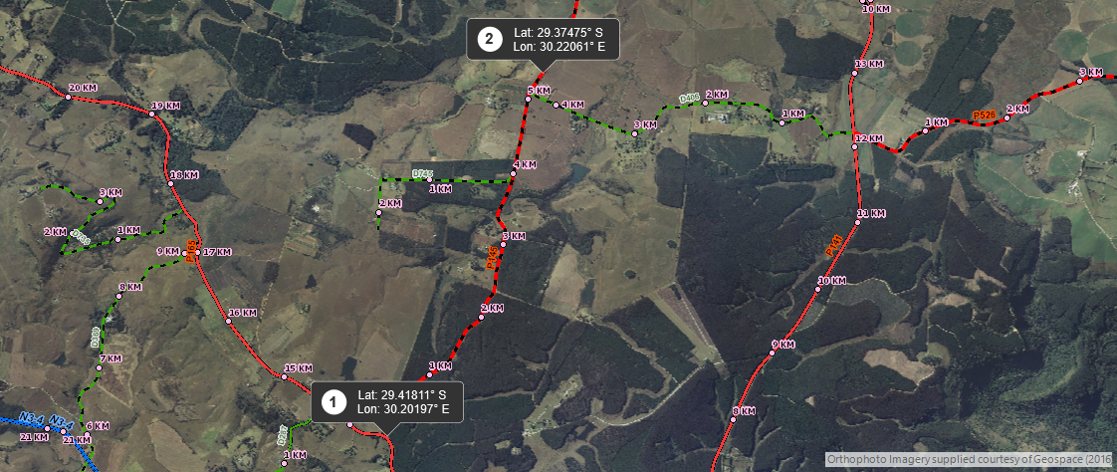
C3.2 PROJECT SPECIFICATIONS
PART A: GENERAL
1.2 Location of the Works …….

Slide 33
C3.2 PROJECT SPECIFICATIONS
PART A: GENERAL
1.3 Overview of the Works
The Work to be carried out includes the following:
The Work to be carried out includes the following:
Establishment and De-establishment
Provision of traffic accommodation facilities,
Roadbed preparation,
Dumping of gravel material,
Pavement layers of 150 mm gravel compacted 95 % mod AASH
Continuous quality control over materials and workmanship, and compliance with the Particular Specifications with regard to environmental management and occupational health and safety, during all the above construction activities,
Clearing of road reserve
Finishing and tidying of the road and road reserve
Refer to pg. C41

Slide 34
C3.2 PROJECT SPECIFICATIONS
PART A: GENERAL
1.4 Extent of the Works
A brief detail of the works for which this specification is applicable is as follows:
Roadworks
(a) The design pavement structure is summarized in the following tables:-
Refer to pg. C42
Layer | Thickness (mm) | TRH 14 Code | Description | Compaction (%)
Gravel Wearing Course | 150 | - | Gravel selected from road prism or local borrow pits | 95% Mod AASHTO

Slide 35
C3.2 PROJECT SPECIFICATIONS…………….
PART A: GENERAL
1.4 Extent of the Works
(b) Material sources and quantities
Refer to pg. C42
Description | Source | Approximate quantity
Gravel Wearing Course 1 x 150mm | Gravel selected from road prism or local borrow pits | 7164 m³

Slide 36
C3.2 PROJECT SPECIFICATIONS
PART A: GENERAL
1.5.1 Access to the Site
Access to the site can be obtained from P145 & L805 in the uMngeni Local Municipality (KZ222).
Throughout the duration of the contract, Roads shall be shared with other contractors engaged by the KwaZulu-Natal Department of Transport on the identified projects whose construction activities may affect access from time to time. The Contractor shall therefore be required to liaise on an ongoing basis with these other contractors with respect to access related matters throughout the duration of the contract.
Refer to pg. C42

Slide 37
C3.2 PROJECT SPECIFICATIONS
PART A: GENERAL
1.5.6 Material sources, spoil and stockpile areas
Refer to pg. C43
The Borrow pit for P145 and L805 is located at approximately at km marker 21+500 on D369 on the right-hand side. The borrow pit is 0,5 km away from D369,16.70km away from 145 AND 21.500 km away from L805 total kilom15.32 kilometers.
D369 | 29.45755°S | 30.15632°E

Slide 38
C3.2 PROJECT SPECIFICATIONS
PART A: GENERAL
1.7 Testing of materials
The Contractor shall arrange for all tests required for process control to be done by a laboratory acceptable to and approved by the Engineer.
Laboratory must operates under the auspices of a SANAS accreditation and with the necessary quality assurance plans.
Refer to pg. C44

Slide 39
C3.2 PROJECT SPECIFICATIONS
PART A: GENERAL
1.10 Contractor’s campsite (Project Specific) f materials
The Contractor shall make his own arrangements for the provision of his campsite and housing for construction personnel but the chosen site shall be subject to the approval of the Employer’s Agent and the local authorities.
The standard of the Contractor's camp, offices, accommodation, ablution, and other facilities must comply with the requirements of all local authority, environmental and industrial regulations concerned. In establishing and maintaining his campsite, due cognisance is to be taken of the requirements of clause A1.3.3 of the Standard Specifications for Road and Bridge Works for South African Road Authorities (COTO), Draft Standard (DS), October 2020.
Refer to pg. C45

Slide 40
C3.2 PROJECT SPECIFICATIONS
PART A: GENERAL
1.12 Construction programme
The Contractor shall submit a detailed time programme in accordance with clause 5.6.2 of the General Conditions of Contract 2015, clause A1.2.7 of the Standard Specifications for Road and Bridge Works for South African Road Authorities (COTO), Draft Standard (DS), October 2020.
Refer to pg. C45

Slide 41
C3.2 PROJECT SPECIFICATIONS
PART A: GENERAL
5.7 Daily records
A site diary is to be compiled jointly by the Construction Manager and the Employer’s Agent’s Representatives on site and is to be agreed and signed by both parties. The original signed copy is to be retained by the Employer’s Agent’s Representative.
The Contractor is to keep daily records of people and equipment on site in a format to be agreed by the Employer’s Agent’s Representative, and is to provide copies to the Employer’s Agent’s Representative when requested.
Refer to pg. C51

Slide 42
C3.2 PROJECT SPECIFICATIONS
PART A: GENERAL
5.8 Payment certificates
Details of measurements, proof of payment for items contained in provisional sums and prime cost sums, proof of ownership of Plant and materials on site and documentation pertaining to contract price adjustment and special materials, are required as substantiation of claims for payment.
Refer to pg. C51

Slide 43
C3.2 PROJECT SPECIFICATIONS…………….
PART A: GENERAL
5.11 Submission of reports
Refer to pg. C51
The contractor shall submit monthly reports in accordance with the specifications in Part E: Expanded Public Works Programme

Slide 44
PART C4: SITE/BACKGROUND INFORMATION
Provincial Road P145 is located in the curry post area under uMngeni Municipality and within the UMgungundlovu District Municipality and Local Road L805 is located in Mpophomeni (Mashingini) Area.
Section under consideration from P km 0+00 to km 5+380 serves the community of approximately 120 people and L805 from km 0+00 to km 2+020 and its serves community of approximately 180 people in wards 8 under the leadership of Cllr Mr S Buthelezi in kwaNxamalala Tribal Authority.
Position | Lat | Lon
@ P145 Start km 0+000 | 29,41811°S | 30,20197°E
End km 5+380 | 29,37475°S | 30,22061°E
Position | Lat | Lon
@ L805 Start km 0+000 | 29,59646°S | 30,19438°E
End km 2+020 | 29,59392°S | 30,21324°E

Slide 45
Coordinates of P145 from 0+000km to 5+380km

Slide 46
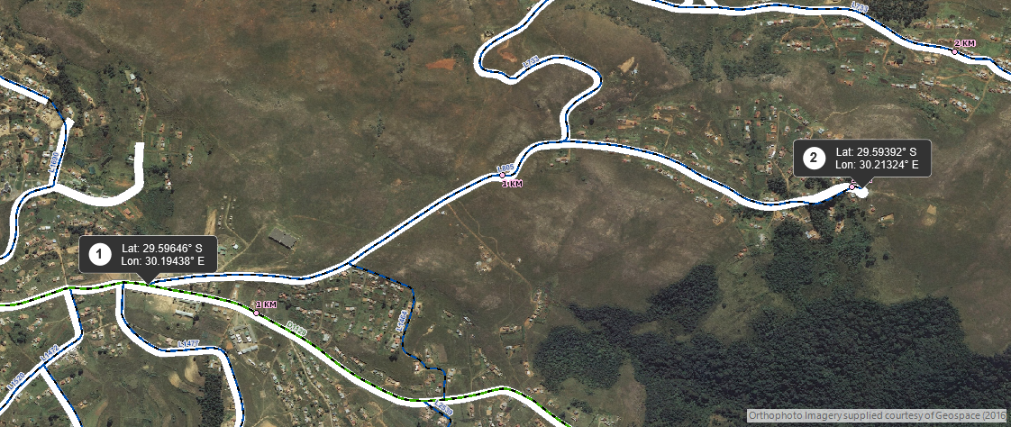
Coordinates of L805 from 0+000km to 2+020km

Slide 47
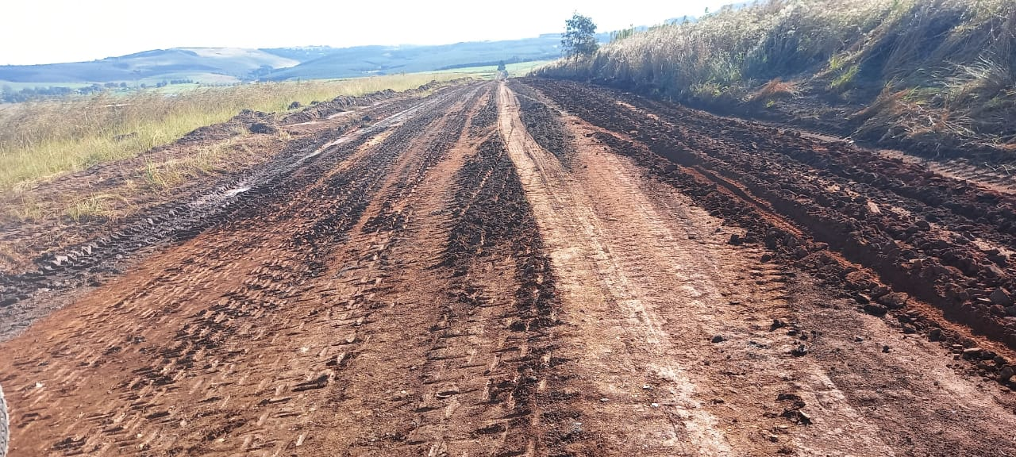
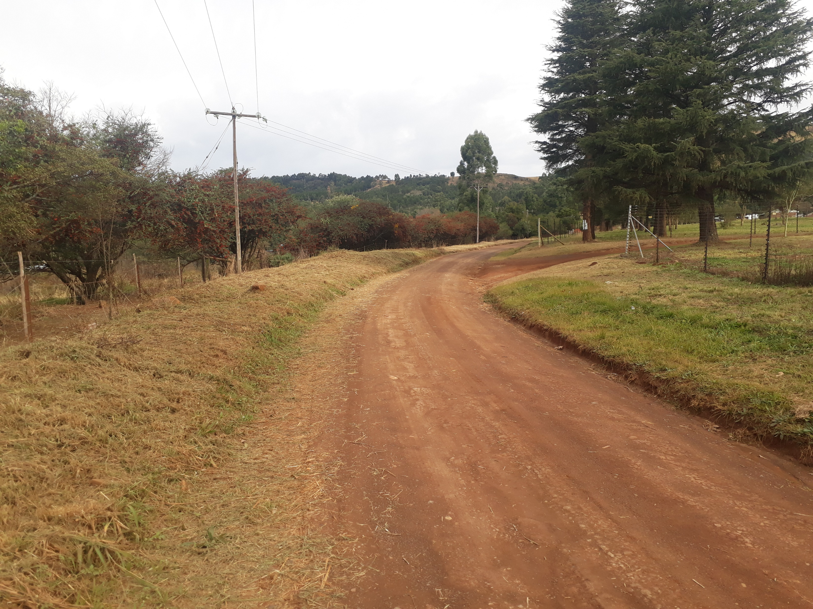
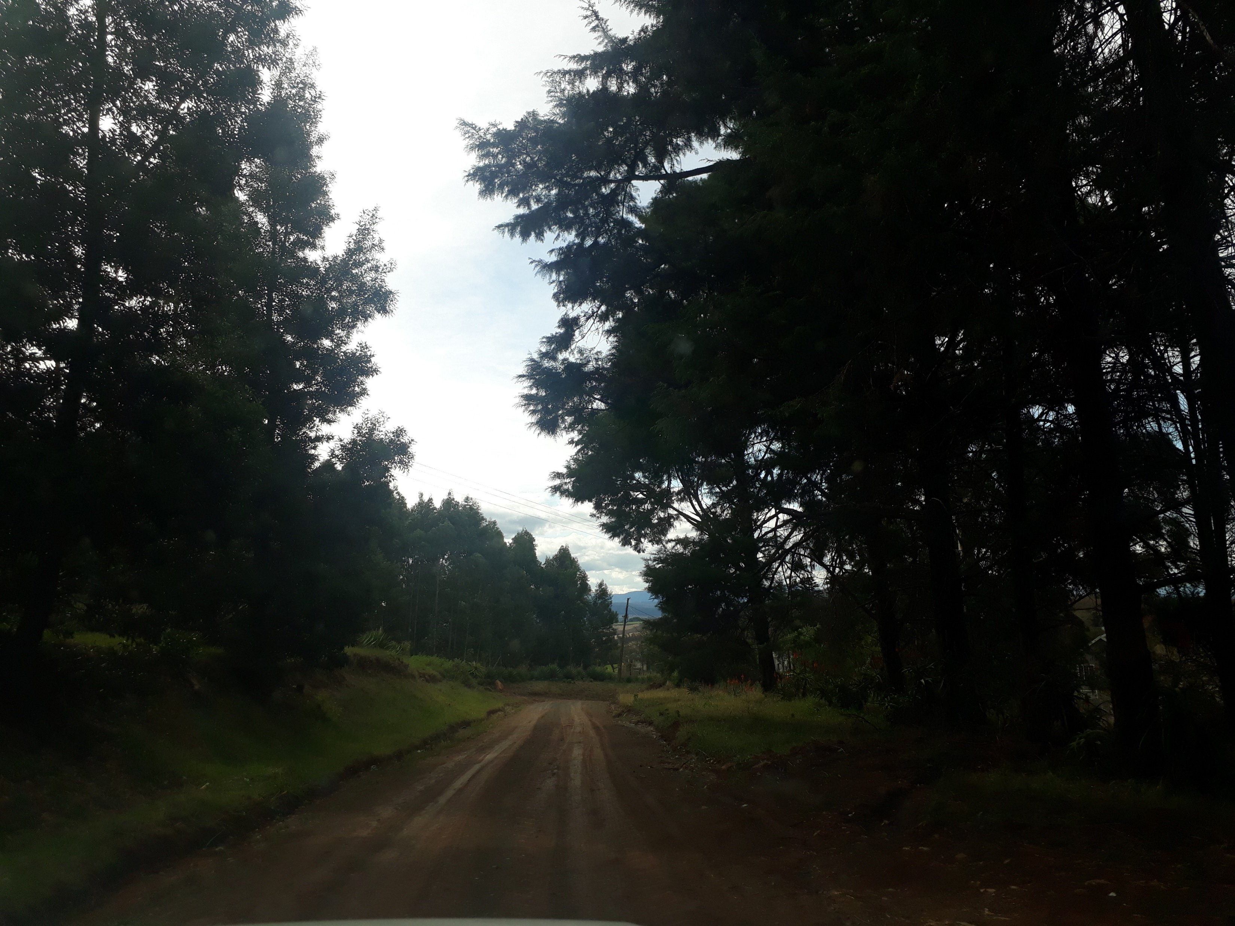
P145 & L805

Slide 48


END/ THANK YOU

